Slide 1
Review Response Data with an R Shiny App
Anthor: Hengwei Liu
Bio: Hengwei Liu is director, statistical programming at Hengrui USA in Princeton, New Jersey. He has been working in the pharmaceutical industry since 2003. He is interested in developing programming tools with SAS, R and Python.

Slide 2
How does an R Shiny App Work?
A published R shiny app is a web page.
The users open the web page, upload some files to the app; the app produces figures.
The users do not need to know R programming language.

Slide 3
Review Overall Response
Overall response is based on target response, non-target response and new lesion progression.
Target lesions | Non-target lesions | New lesions | Overall response
CR | CR | No | CR
CR | Non-CR/non-PD | No | PR
CR | Not evaluated | No | PR
PR | Non-PD or not all evaluated | No | PR
SD | Non-PD or not all evaluated | No | SD
Not all evaluated | Non-PD | No | NE
PD | Any | Yes or No | PD
Any | PD | Yes or No | PD
Any | Any | Yes | PD

Slide 4
Review Target Response
If the sum of diameters is 0, let response=CR.
Else if percent change from baseline in sum of diameters <= -30, let response=PR.
Else if sum of diameters is not missing, let response=SD.
Else let response=NE.
If percent change from nadir in sum of diameters >=20 and the absolute change from nadir >= 5 mm, let response=PD.
Note that the target response is CR when sum of diameters is not 0, but the non-zero result is contributed by pathological lymph nodes with short axis < 10 mm. This scenario is not evident in the output of the R shiny app.

Slide 5
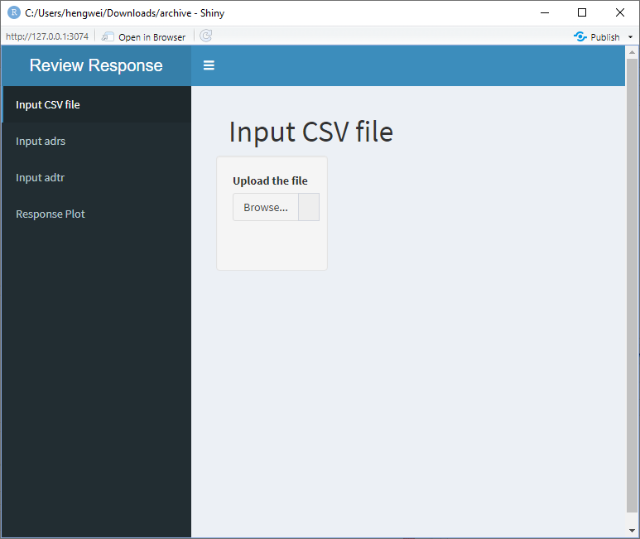
Dashboard of the R Shiny App

Slide 6
Workflow of Using the App
User fills out the CSV file. In the CSV file the user specifies the conditions used to get a subset of the datasets ADRS and ADTR.
User uploads the CSV file, the SAS datasets ADTR and ADRS to the app.
User clicks on the tab for figure in the shiny app and creates the figure.

Slide 7
Structure of the CSV File
ADRS | The conditions used to get a subset of ADRS
ADTR | The conditions used to get a subset of ADTR

Slide 8
A Sample of the CSV File
ADRS | adrs$PARQUAL=='CENTRAL' & adrs$RSACPTFL=='Y' & ( adrs$PARAMCD=='OVRLRESP' | adrs$PARAMCD=='TRGRESP' | adrs$PARAMCD=='NTRGRESP' | adrs$PARAMCD=='NEWLPROG')
ADTR | adtr$PARQUAL=='CENTRAL' & adtr$ANL01FL=='Y' & adtr$PARAMCD=='SUMDIAM' &adtr$TRACPTFL=='Y'

Slide 9
Variables Required in the ADRS
Dataset | Variable | Label | Note
ADRS | USUBJID | Unique Subject identifier
ADRS | PARAMCD | Parameter Code | We need the parameter codes for target response, non-target response, new lesion progression and overall response in the CSV file.
ADRS | PARAM | Parameter
ADRS | AVALC | Analysis Value (C)
ADRS | ADY | Analysis Relative Day
ADRS | PARQUAL | Evaluator | The evaluator can be independent central review (ICR) or Investigator.
ADRS | RSACPTFL | Acceptance Flag | This flag indicates which record is accepted from multiple evaluators in ICR.

Slide 10
Variables Required in the ADTR
Dataset | Variable | Label | Note
ADTR | USUBJID | Unique Subject Identifier
ADTR | PARAMCD | Parameter Code | We need the parameter code for the sum of diameters in the CSV file.
ADTR | AVAL | Analysis Value
ADTR | ADY | Analysis Relative Day
ADTR | ANL01FL | Analysis Flag 01 | If the number of target lesions with non-missing result at a post-baseline visit is less than that at baseline, the post-baseline record will not be flagged for analysis.
ADTR | PCHG | Percent Change from Baseline
ADTR | NADIR | Nadir | Nadir for a visit is defined as the smallest sum of diameters prior to the visit.
ADTR | PCNSD | Percent Change from Nadir
ADTR | ABLFL | Baseline Record Flag
ADTR | PARQUAL | Evaluator | The evaluator can be independent central review (ICR) or Investigator.
ADTR | TRACPTFL | Acceptance Flag | This flag indicates which record is accepted from multiple evaluators in ICR.

Slide 11
Some Interesting Points
The default size for input file is 5 MB in R shiny app. We can use options to increase the size. For example, if we want to input a file up to 30 MB:
options(shiny.maxRequestSize = 30*1024^2)

Slide 12
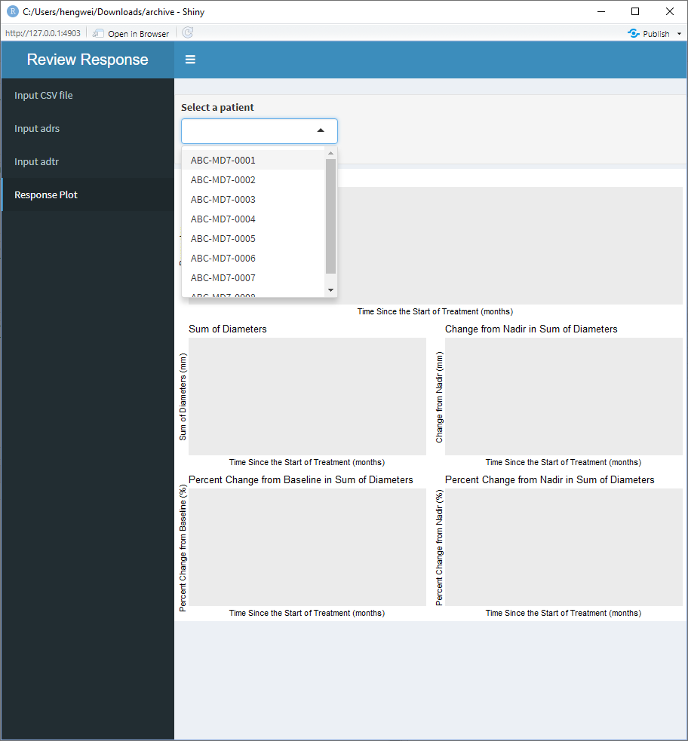
Some Interesting Points, Cont.
This app is designed to create some plots for each patient. We use a dropdown menu to provide the list of patients for the users to choose from.

Slide 13
Some Interesting Points, Cont.
The R packages haven and sas7bdat can read SAS datasets. But the package sas7bdat can only read un-compressed datasets. If the SAS datasets are compressed, we need to use the haven package with the function read_sas to read the SAS datasets.

Slide 14
Some Interesting Points, Cont.
In the CSV file there is the condition to get a subset of the ADRS dataset. To read that condition into the R shiny program, we use this trick: eval(parse(text= paste0('subset(adrs,' , vr,')' ))).

Slide 15
Some Interesting Points, Cont.
When we use ggplot to create the plot for the target response, non-target response, new lesion progression and overall response, we use the function scale_shape_manual to ensure that there are enough symbols in the legend.
scale_shape_manual(values=1:length(unique(adrs$AVALC)))

Slide 16
Some Interesting Points, Cont.
The line plots for sum of diameters, percent change from baseline, change from nadir and percent change from nadir are displayed in a 2x2 format. This is achieved through grid.arrange function in the package gridExtra:
ptlist <- list(myPlot1, myPlot3, myPlot2, myPlot4)
grid.arrange(grobs=ptlist,ncol=2, nrow=2)

Slide 17
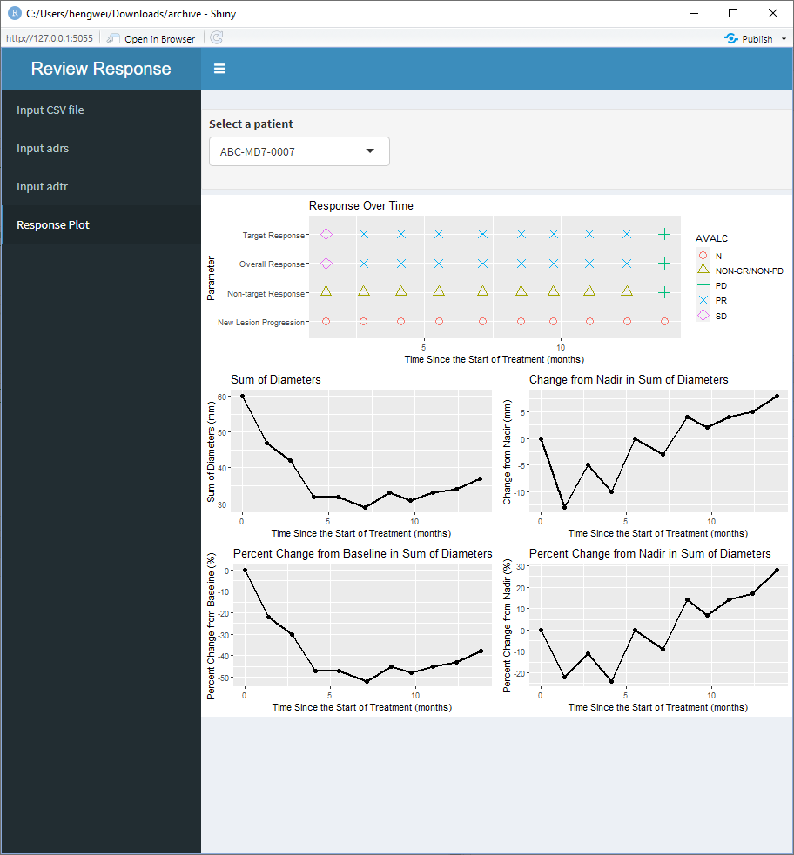
Sample Output of the App

Slide 18
Conclusion
R shiny can be used to create powerful visualization tools for clinical studies.
In this paper we have shown how to create an R shiny app which produces figures for the response and tumor data after the user uploads the tumor data, response data and a CSV file to the app. The users can review the figures to identify possible data issues based on the RECIST 1.1.

Slide 19
Name: Hengwei Liu
Organization: Hengrui USA
Address: 400 Alexander Park
City, State ZIP: Princeton, NJ 08540
E-mail: hengwei_liu@yahoo.com
WeChat: liuhengwei70

